Slide 1
The Least Secure Lock on Earth?

Slide 2
Introduction
Seth Kintigh
Hardware hacker
Dell Hardware Security Engineer

Slide 3
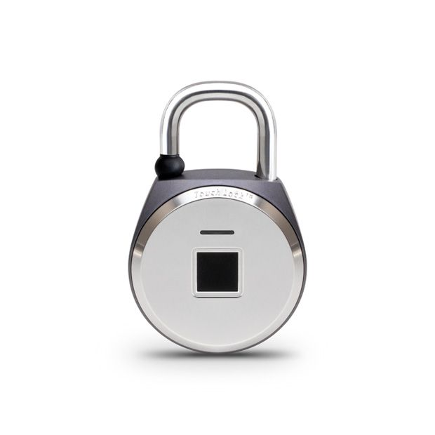
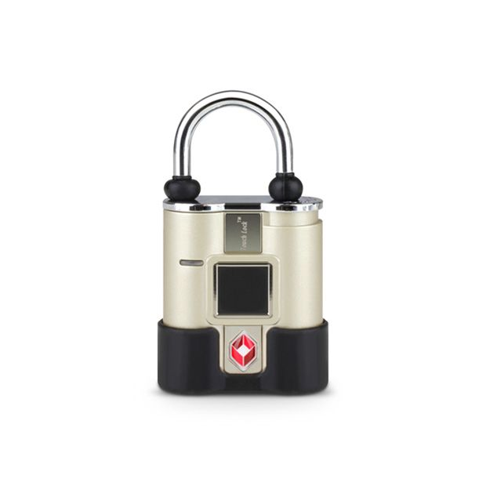
The TouchLock
Aluratek Touchlock
a.k.a “Bio-Key TouchLock XL All Weather Keyless Bio-Lock with Fingerprint Recognition”
Knockoff of TappLock?
Related locks:
Hunting down info on FCC website I discovered there aren't just 2 of these products, but at least 8, maybe more.
Other brands may use this same chip and code, based on product descriptions

Slide 4
TappLock
The previous worst biometric lock was the TappLock fingerprint lock
It effectively broadcasted its key over Bluetooth (now fixed)
TouchLock has a Windows app instead of a phone app.
The TappLock has a “Morse Code” feature for unlocking it with a sequence of up to 12 short or long presses
TouchLock copies that, but worse.

Slide 5
Fingerprints as Passwords/Keys
Fingerprints are unchangeable and you leave a copy of them on literally everything you touch
Exactly the qualities you want in a password.
Why not protect your physical possessions with them, too?
The lock has a fingerprint reader, this is the primary intended way to unlock it
Works well, kinda nifty

Slide 6
Manual Brute Force Attack
2nd intended way to open it: "Morse Code“ pattern of short or long presses
TappLock has a similar feature of 6 to 12 long patterns; keyspace is 8128 codes.
Touchlock allows exactly 6 presses for a keyspace of 2^6 or 64 possible keys.
Takes about 18 seconds to test 4 average patterns,
All 64 will take just over 14 min, on average 7 min to crack the lock

Slide 7
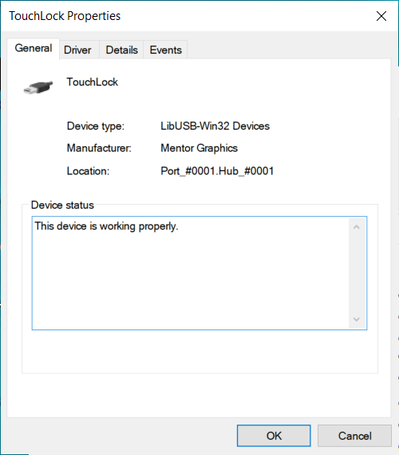
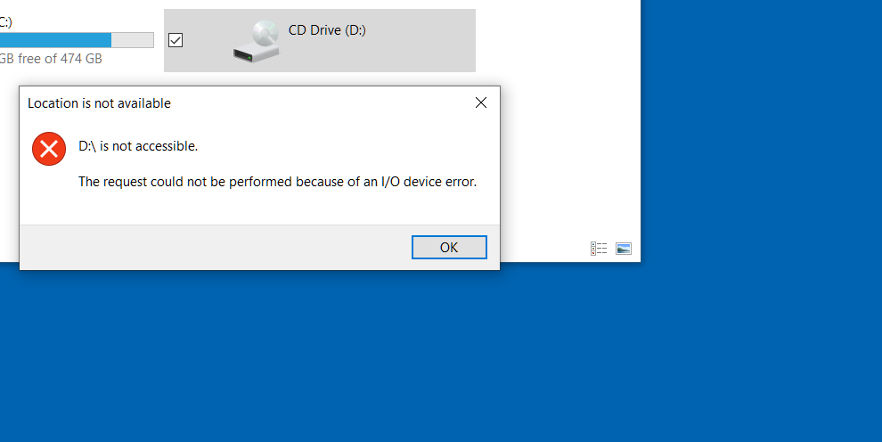
USB Brute Force attack
The lock has yet another way to open it: a PIN sent over USB from a Windows app.
Lock identifies as a Mentor Graphics CDROM
Windows tries to mount that drive and fails instantly, probably because it's a lock.
This PIN feature is mandatory
If you don't set the PIN, it is still active with a default PIN
Default PIN is set to 0000

Slide 8
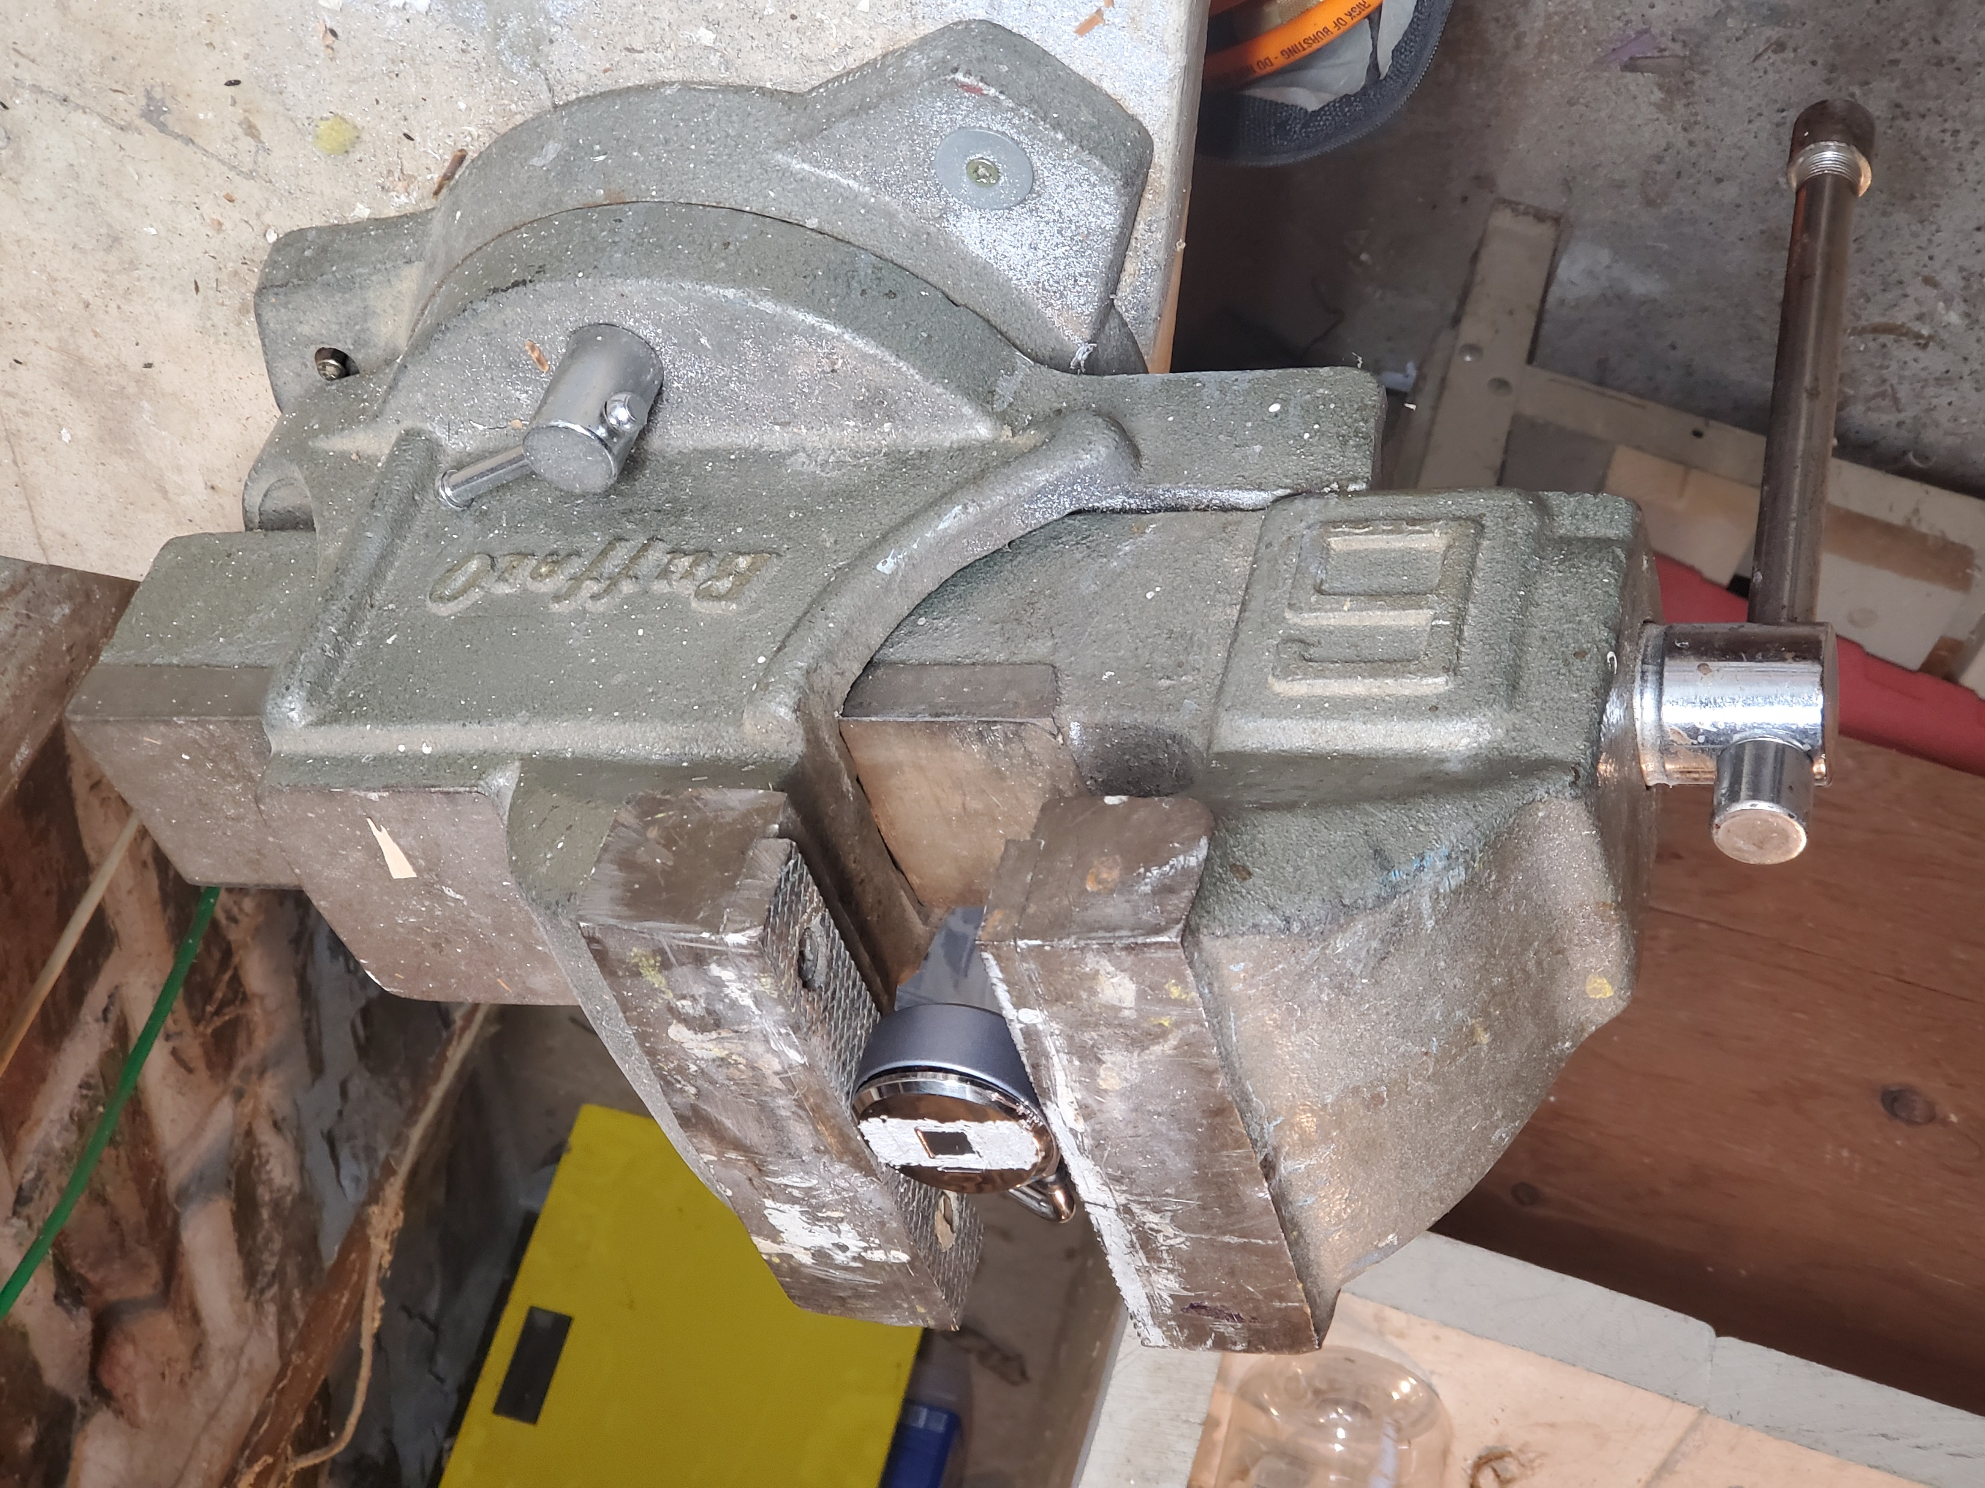
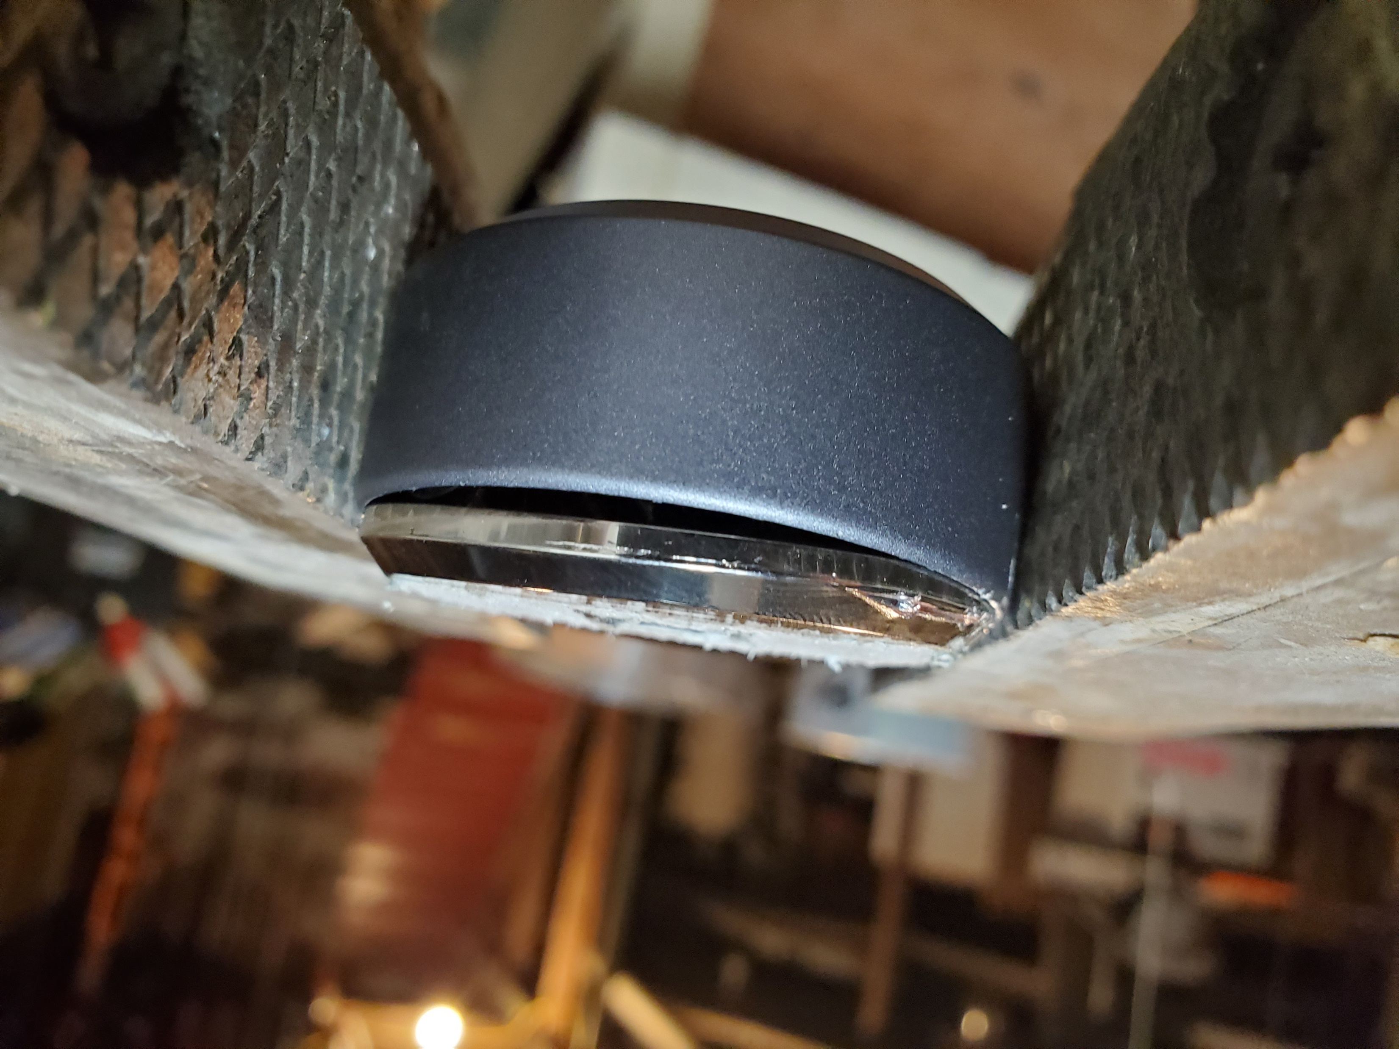
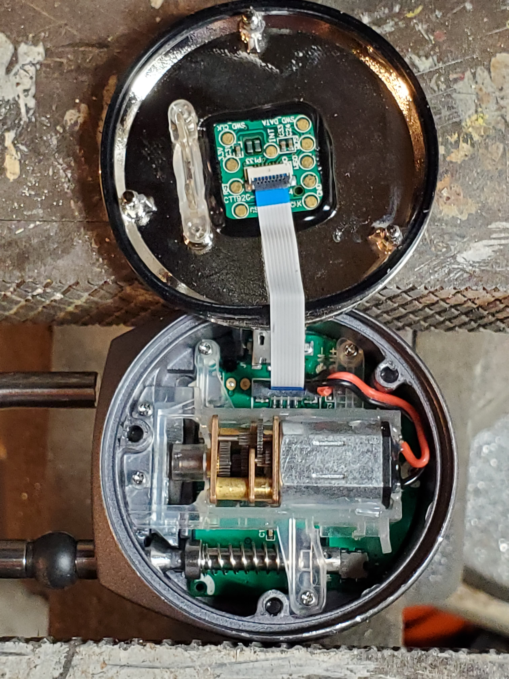
Physical Penetration
I tried prying it open and using a chisel, but the lock kept moving
In order to keep is still I clamped in a vice, and heard some popping noises
I tightened the clamp, heard more popping noises.
Tightened it more, and *pop* the front popped off, revealing all the electronic and mechanics.
Not welded together
Not even screwed together
Held on by tension and a rubber gasket.
This is a very fast attack, but requires a 50 lbs vice. Not super practical.

Slide 9
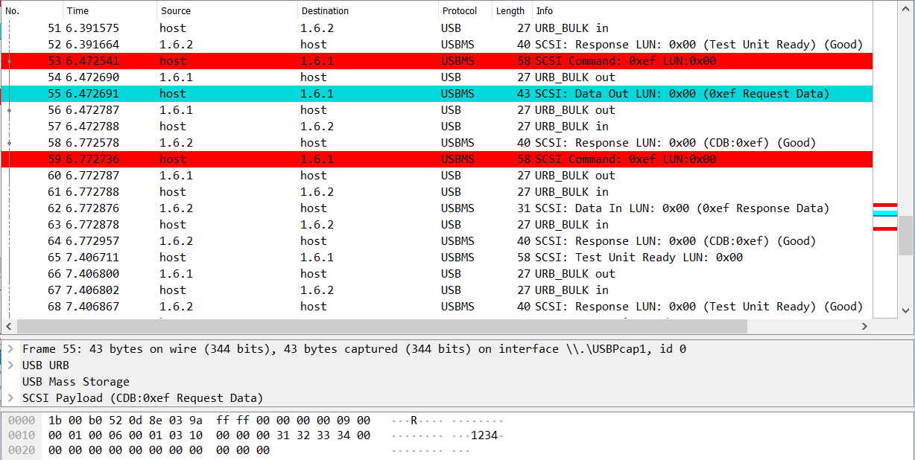
Analyzing USB Traffic
Used Wireshark for USB capture while using the PIN entry app, saw 3 packets per PIN test

Slide 10
Analyzing USB Traffic
I analyzed the USB traffic, observed a pattern of 3 packets:
Command Block Wrapper (CBW)
Data transfer
Command Status Wrapper (CSW)
Packets are Mass Storage Device USB Bulk Data transfers/SCSI

Slide 11
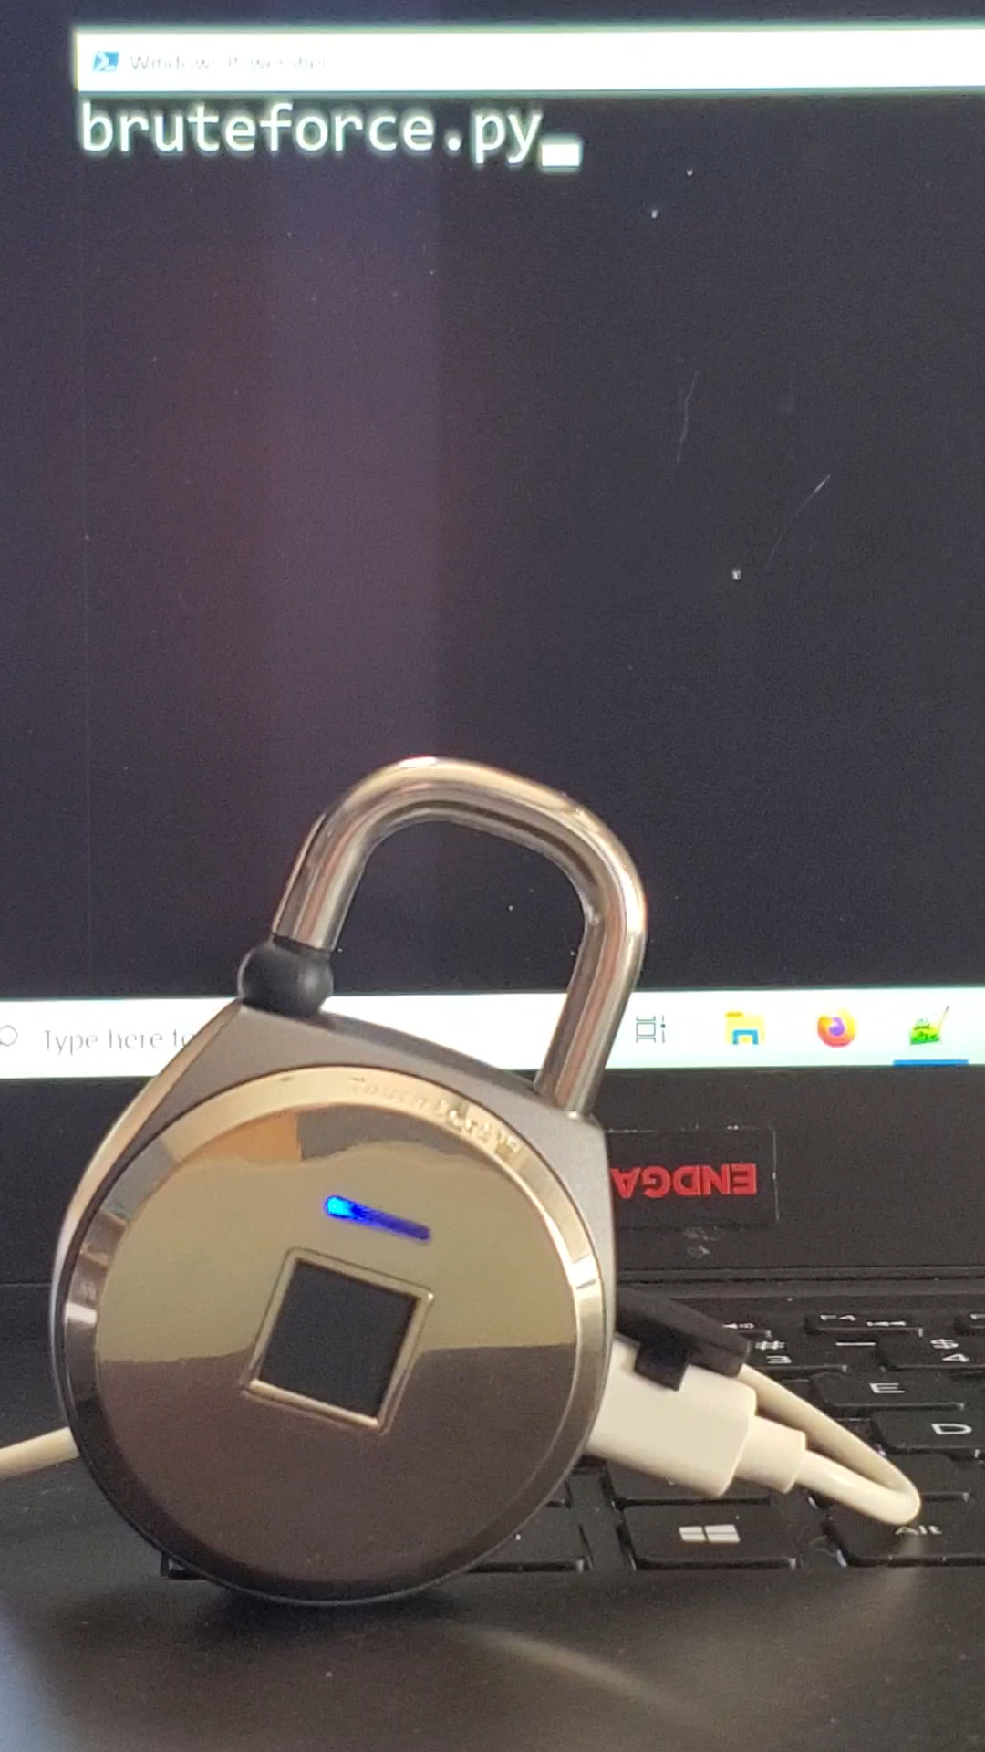
The USB Attack
Python script using PyUSB library to test all possible PINs
Can test a PIN in 2 or 3 packets

Slide 12
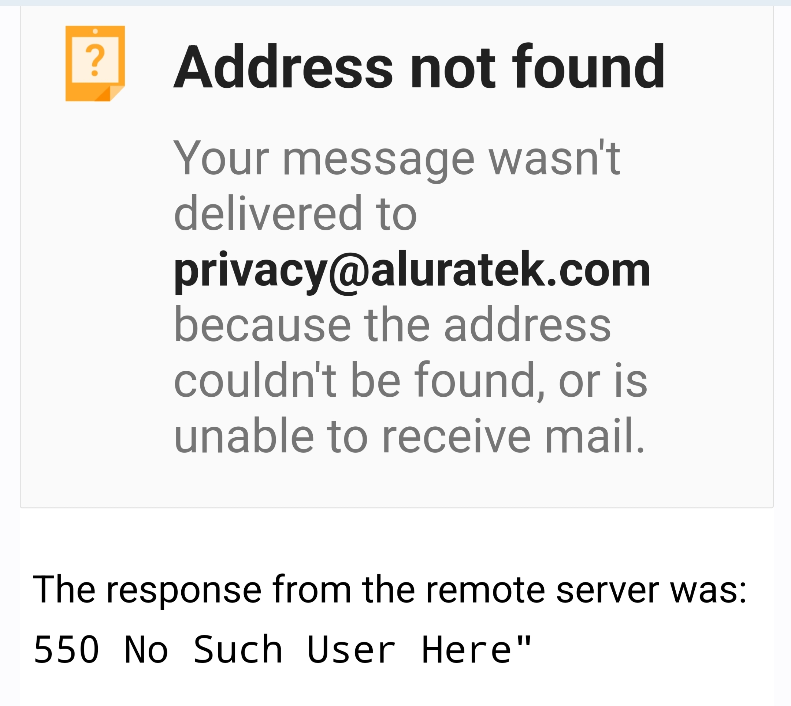
Company Response

Slide 13
Conclusion
Don't buy this lock
Script available at github.com/skintigh

